Slide 1
Global weather analysis
Jana sri g
23bds017

Slide 2
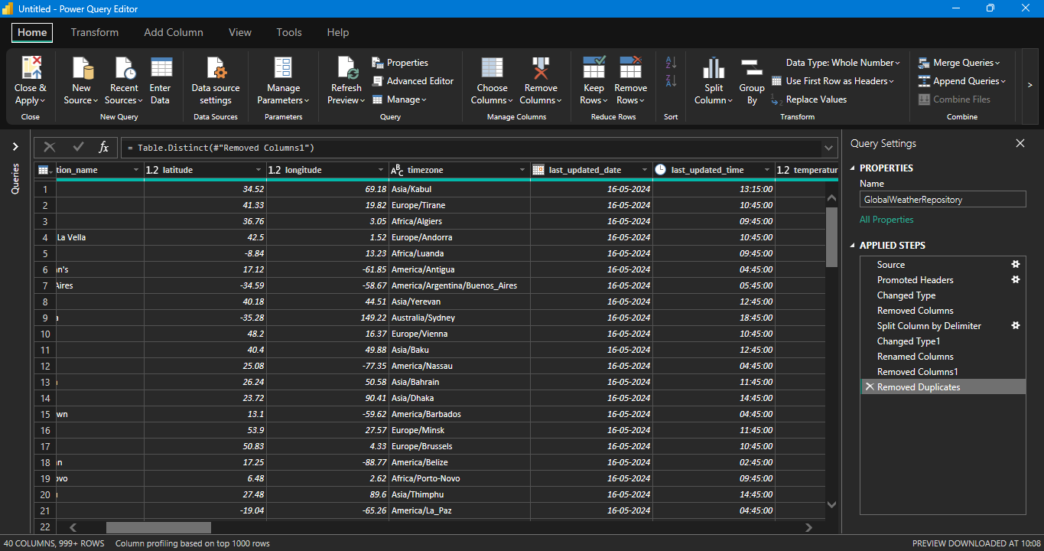

Slide 3
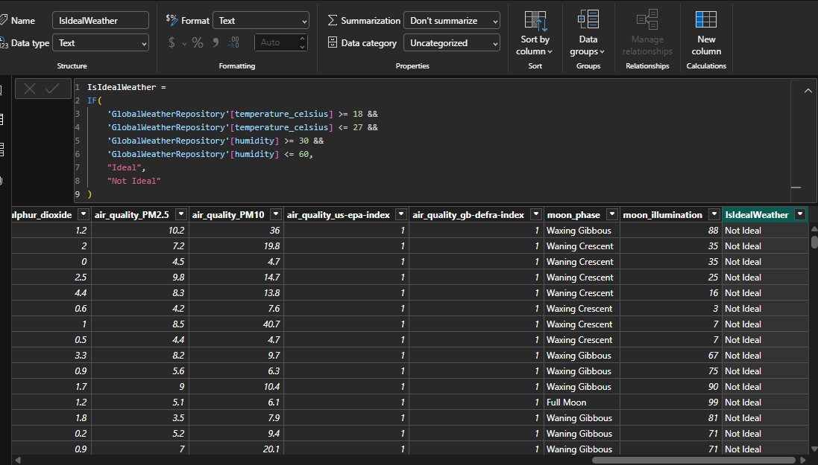
DAX function

Slide 4
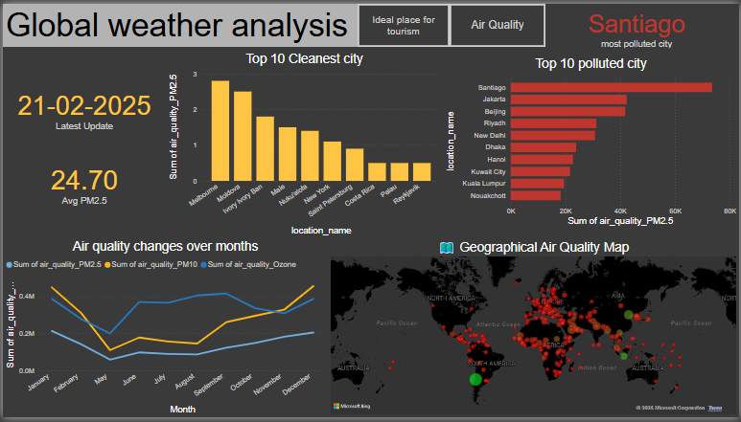

Slide 5
